Slide 1


Presentation on Email Header Analysis and Network Traffic In Wire Shark
Presented By:- Kundan Keshav Gawande(28806)

Slide 2

HTTP (Hypertext Transfer Protocol)
Port: 80 (default)
Purpose: Transfers web pages and resources between a client (like a web browser) and a server.
How it works:
A client sends an HTTP request (e.g., GET /index.html) to a server.
The server responds with an HTTP response (status code + content).
Unencrypted: All data is sent in plain text, making it insecure for sensitive info.
Example use: Visiting http://example.com in a browser.

Slide 3

HTTPS (Hypertext Transfer Protocol Secure)
Port: 443 (default)
Purpose: Same as HTTP, but with encryption using TLS (SSL).
How it works:
Uses TLS to establish an encrypted connection before HTTP traffic begins.
Data between browser and server is protected from eavesdropping or tampering.
Secure: Common for login pages, e-commerce, banking, etc.
Example use: Visiting https://example.com.

Slide 4

ICMP (Internet Control Message Protocol)
Port: None (doesn’t use TCP or UDP — it’s its own protocol)
Purpose: Used for diagnostic or error-reporting messages in networks.
How it works:
Most common use is ping, which sends an ICMP Echo Request.
The target replies with an ICMP Echo Reply.
Not used for data transfer, just for checking if a device is reachable.
Example use: Running ping google.com in CMD or terminal.

Slide 5

DNS (Domain Name System)
Port: 53 (uses UDP, sometimes TCP)
Purpose: Translates human-readable domain names (like openai.com) into IP addresses.
How it works:
A client sends a DNS query to a DNS server asking for the IP of a domain.
The server responds with the corresponding IP address.
Essential for browsing, because almost all domain-based traffic starts with a DNS lookup.
Example use: Typing www.youtube.com in a browser — DNS resolves it before connecting.

Slide 6
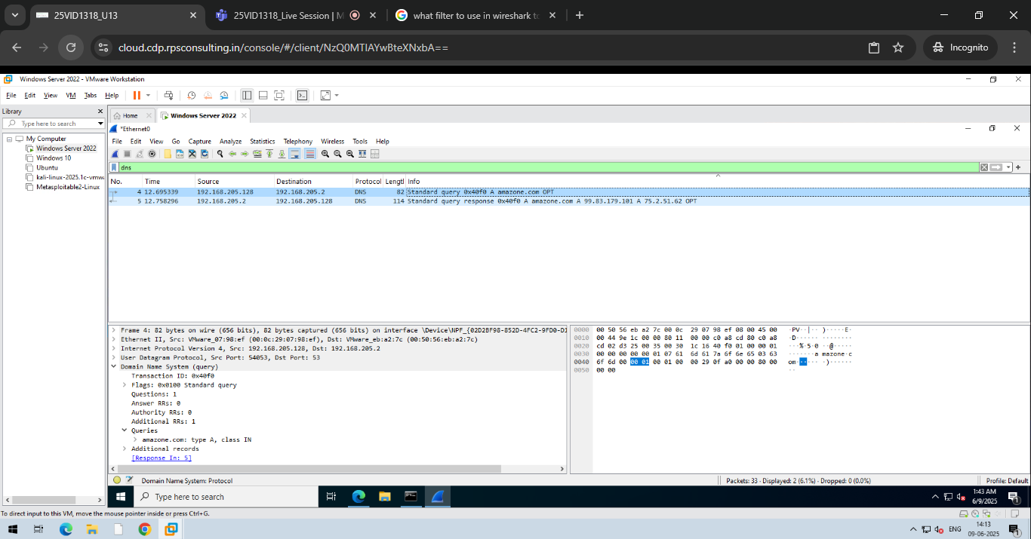
DNS

Slide 7
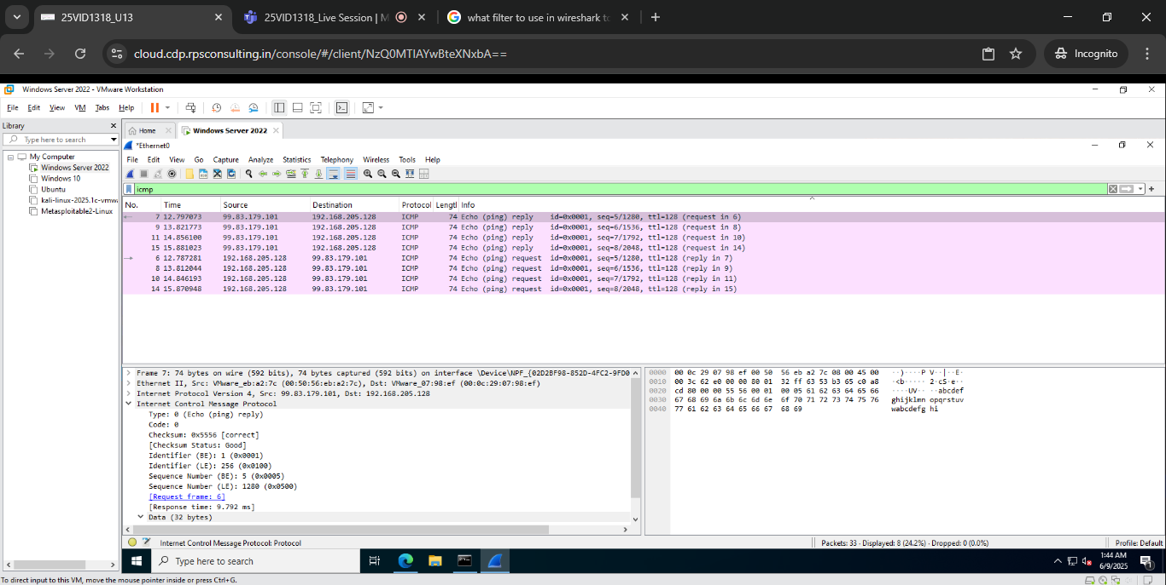
ICMP
ICMP

Slide 8
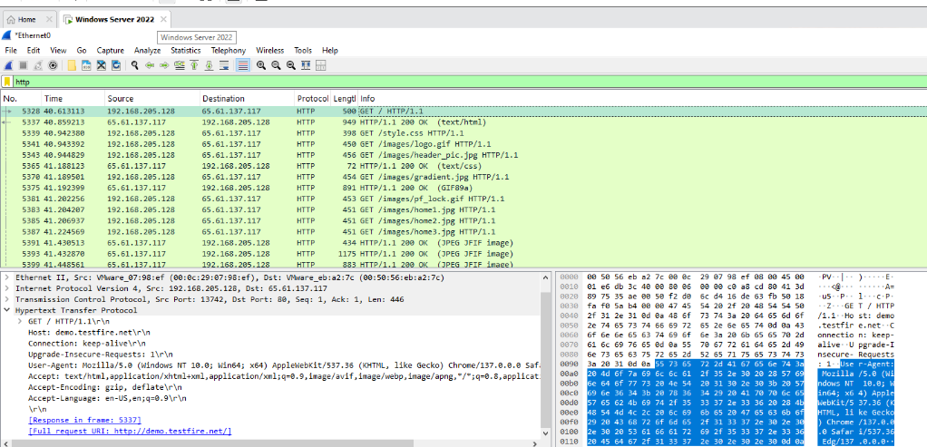
HTTP

Slide 9
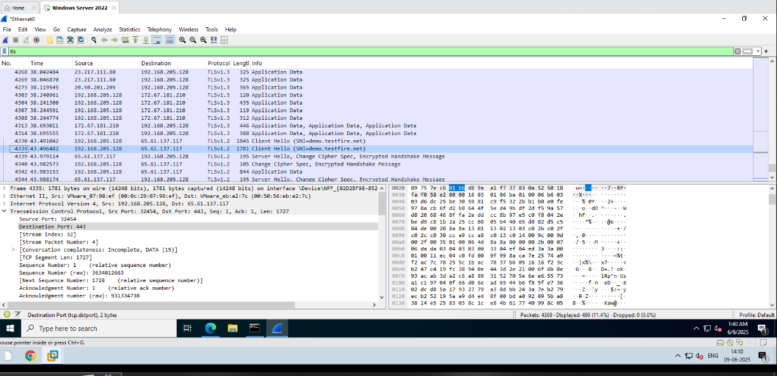
HTTPS

